Slide 1
Decoding Email Unsubscribes A Data Driven Story
Exploring engagement, timing, and audience behavior.
By: Syed Hammad Javed.

Slide 2
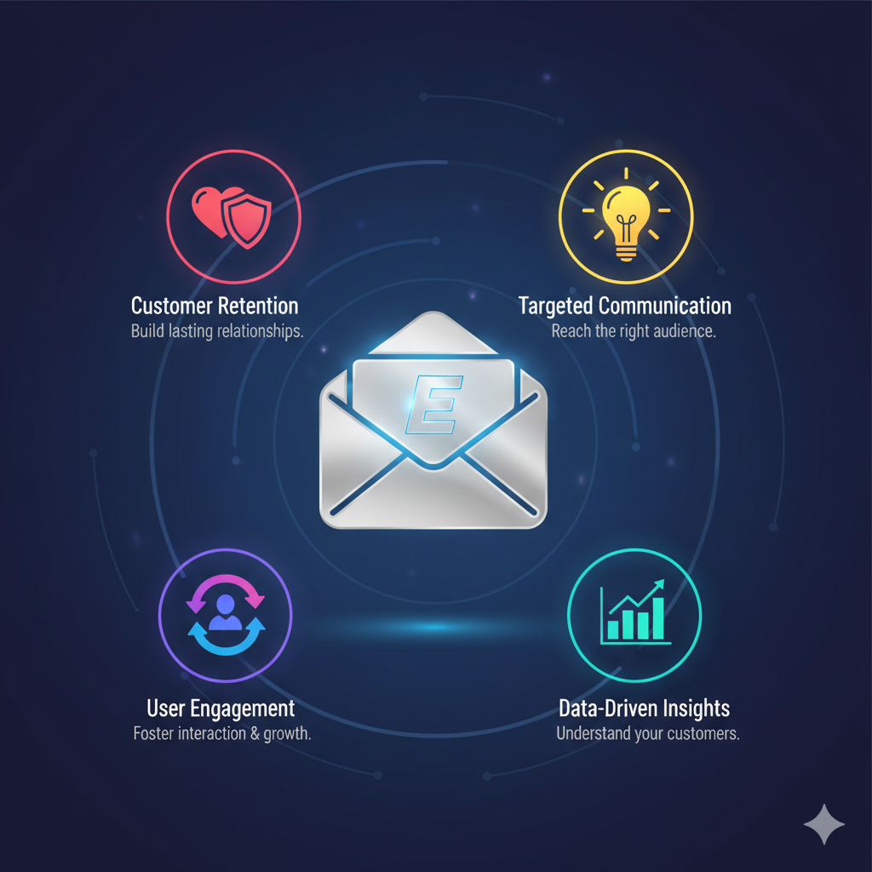
INTRODUCTION
Email marketing is a direct and cost-effective way to engage customers and promote products or services.
It allows targeted communication through personalized campaigns and newsletters.
Key metrics like open rate, click rate, and unsubscribe rate reveal audience engagement and campaign performance.
Analysing these metrics helps optimize content, improve retention, and reduce customer churn.

Slide 3
OBJECTIVE
To analyse email campaign performance and user engagement behavior to identify the factors influencing unsubscribe rates and detect at-risk users for improving customer retention and campaign effectiveness.

Slide 4
DATASET OVERVIEW
📁 Data Source:
Mary Knoeferl Monthly Email Marketing Challenge Database Consists of 5 relational tables capturing campaign, engagement, and unsubscribes.
🧩 Dataset Structure
Table | Key Columns | Purpose
Users | user_id, signup_date, device_type, region, is_active | Contains user demographics and activity status.
Campaigns | campaign_id, campaign_name, send_date, send_hour, category | Defines each email campaign’s metadata
Campaign_Performance | campaign_id, total_sent, total_open, total_clicks, total_unsubscribers | Aggregated campaign-level metrics.
Email_Engagement | engagement_id, user_id, campaign_id, opened, clicked, open_time, unsubscribe | Tracks user-level email interactions.
Unsubscribe | unsubscribe_id, user_id, campaign_id, unsubscribe_date, reason | Details users who unsubscribed and their reasons.

Slide 5

Methodology
Data Extraction: Exported data from SQLite and converted to CSV format.
Data Loading: Imported CSV files into MySQL.
Exploratory Data Analysis: EDA was performed was MySQL.
Visualisation: Used Powerbi for visualization
Presentation: Summarized insights and visual findings into a PowerPoint report.

Slide 6
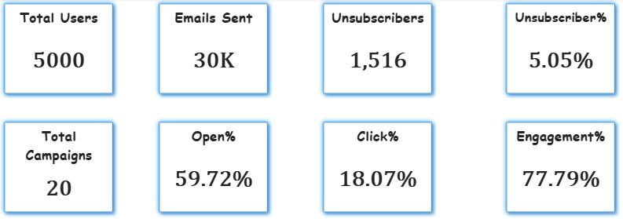
Key Performance Indicators

Slide 7


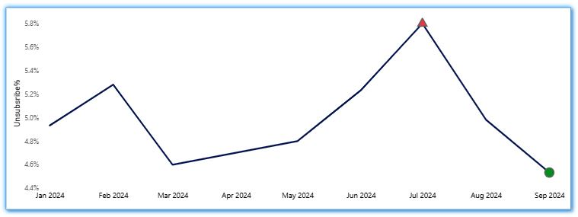

Unsubscribe Rate Analysis
The overall unsubscribe rate is 5.05%, remaining stable from January to June.
It peaked in July 2024 at 5.80%, before improving to its lowest point in September 2024 (4.83%).
Concerns
An unsubscribe rate above 1% is considered alarming in email marketing benchmarks.
A 5.05% rate signals serious audience dissatisfaction users are opting out faster than new ones can be retained.

Slide 8
Why Unsubscribe rate is very high?
Our campaigns achieved a high open rate, indicating that users are interested in reading our emails, and a high click rate, showing that the content successfully motivates users to take action.
However, we also observed a high unsubscribe rate. This suggests that the issue is not in attracting attention, but rather in retaining user trust and satisfaction after engagement.
Possible reasons include:
Misleading or clickbait subject lines.
Overly aggressive follow-up emails.
Privacy concerns (to be discussed in upcoming slides).
Irrelevant or disappointing post-click experience.

Slide 9
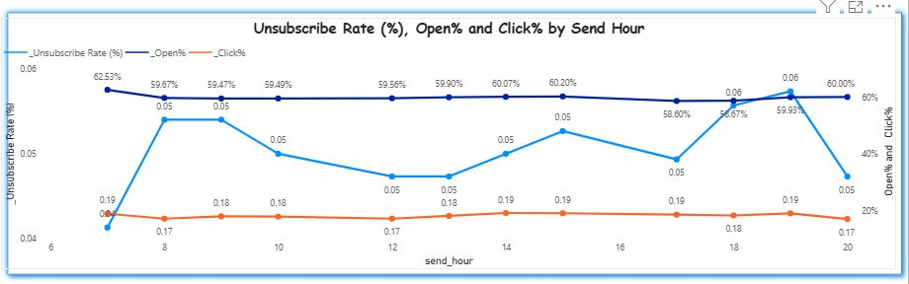
Impact of Send Hour on Unsubscribe Rate
The open rate remains relatively stable across all hours, ranging between 58.6% and 62.5%, while the click rate also stays consistent around 17% to 19%, indicating that engagement after opening is not strongly influenced by send time.
However, the unsubscribe rate shows greater fluctuation between 0.04 and 0.06 peaking around 7 AM, 6 PM, and 7 PM.
This pattern suggests that users are more likely to check emails before and after work hours, resulting in higher engagement but also increased unsubscribe activity, likely driven by email fatigue or frustration during these busy periods.

Slide 10
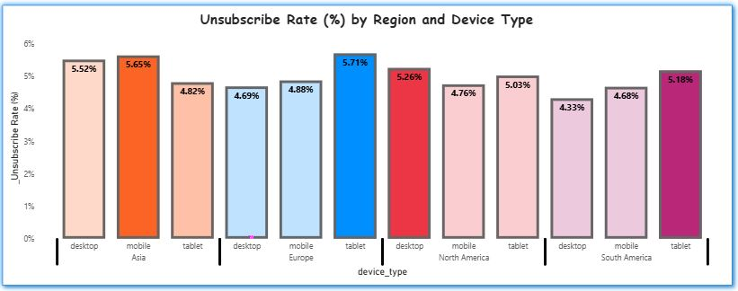
Geography of Unsubscribes
Mobile users in Asia (5.65%) and tablet users in Europe (5.71%) have the highest unsubscribe rates. This suggests possible mobile optimization issues in Asia and tablet-specific design or formatting problems in Europe. Desktop users generally show stronger retention, indicating emails perform better on larger screens.

Slide 11
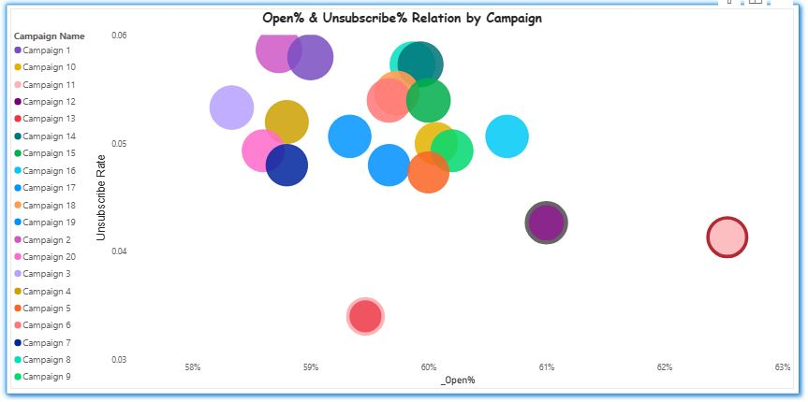
Unsubscribe Rate vs. Open Rate: Key Findings
Open rate is not a reliable indicator of unsubscribe behavior. The main driver of unsubscribes is the quality and relevance of email content, not subject line appeal.
Campaign 13 achieved the lowest unsubscribe rate (3.4%) with a moderate open rate (59.5%), indicating strong content alignment with audience interests.
Several campaigns show high unsubscribe rates (5.5–6%) despite similar open rates (58–61%), suggesting disengagement after opening, likely due to poor content value or mismatch with user expectations.

Slide 12
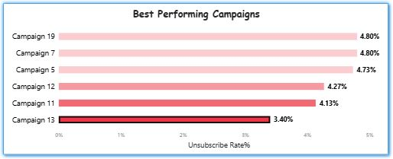
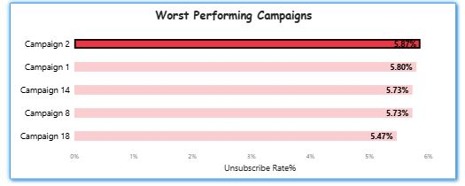
Campaign Performance Overview
Although Unsubscribe rates is very high & vary significantly across campaigns, ranging from 3.4% to 5.9%.
Campaign 13 (3.4%) sets the benchmark for strong audience retention, followed by Campaigns 11 and 12 (4.1–4.3%) with solid performance.
In contrast, Campaigns 1 and 2 (5.8–5.9%) show the highest churn, about 73% higher than the best performer, indicating major content or targeting issues.

Slide 13
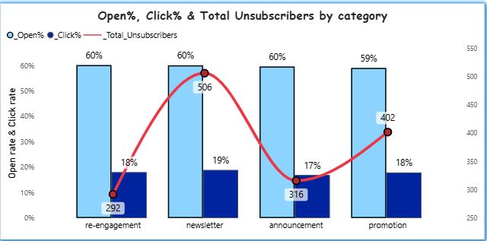
Category wise Engagement & Unsubscribers breakdown.
Engagement rates remain steady across categories (Open: 59–60%, Click: 18%), but the Newsletter category drives the highest churn with 506 unsubscribes. This can be due to privacy Concerns or over frequency within newsletters, requiring immediate optimization of send strategy and content relevance.

Slide 14
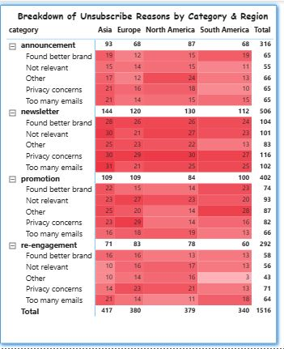
Why Users Are Unsubscribing?
Unsubscribe rate stands at 5.05%, driven mainly by privacy concerns (334), irrelevant content (305), too many emails (297).Asia shows the highest churn (417 unsubscribes) due to frequency overload, while Europe leads in brand switching (162).Overall, weak content relevance and low trust remain the key causes of user attrition.

Slide 15
Summary Of Key Findings.
1. Overall Performance
Average unsubscribe rate: 5.05%, well above the acceptable benchmark of 1–2%.
Peak churn in July 2024 (5.8%), lowest in September 2024 (4.8%).
2. Campaign-Level Insights
Campaign 13 (3.4%) sets the benchmark for strong content and targeting.
Campaigns 1 & 2 (5.75%) show critical weaknesses causing high churn.
3. Category & Region Trends
Newsletter category leads in total unsubscribes (506).
Asia shows high churn due to excessive email frequency (417 unsubscribes).
Europe churn driven by “better brand” perception (162 cases).
4. Core Reasons for High Unsubscribes
Privacy Concerns (334) Lack of user trust and data transparency.
Too Many Emails (297) Poor frequency management.
Irrelevant Content (395) Weak personalization and targeting.

Slide 16
Strategic Recommendations
Content & Targeting
Since Engagement Rate is good but still our unsubscribe rate is high which means there is some issue with content. We need to refine content strategy to improve relevance and personalization.
Also we need to overhaul the newsletter content because it brings one third of unsubscribers.
2. Frequency Optimization Reduce send frequency for Asia and Newsletter campaigns where fatigue is highest. Adopt engagement-based scheduling send fewer emails to low-activity users.

Slide 17
Strategic Recommendations
3. Trust & Compliance Address privacy concerns by clearly communicating data usage policies. Add visible unsubscribe options and reinforce transparency in email footers.
4. Segmentation & Personalization Leverage region and device_type fields to tailor message timing and format. Use behavioural data to customize content for re-engagement and promotions.

